Slide 1

Wireframe Group Project
LoneLight Coffee House

Slide 2
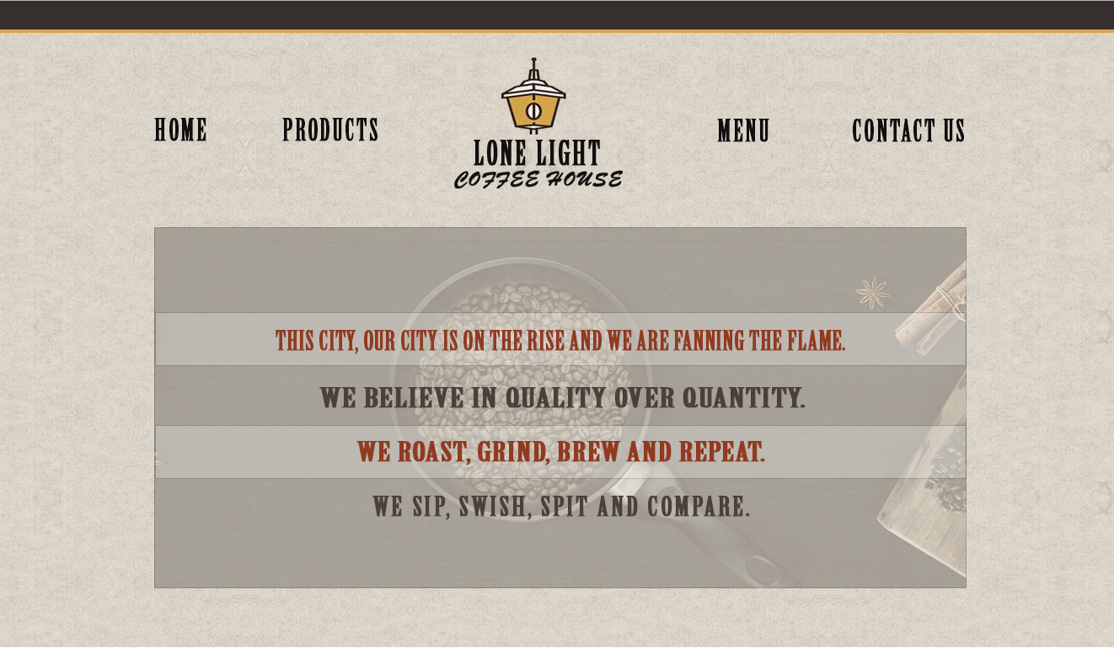
HOME
Lonelight Coffee House is a cafe with a choosy selection of coffee. This page provides a brief introduction of café atmosphere.

Slide 3
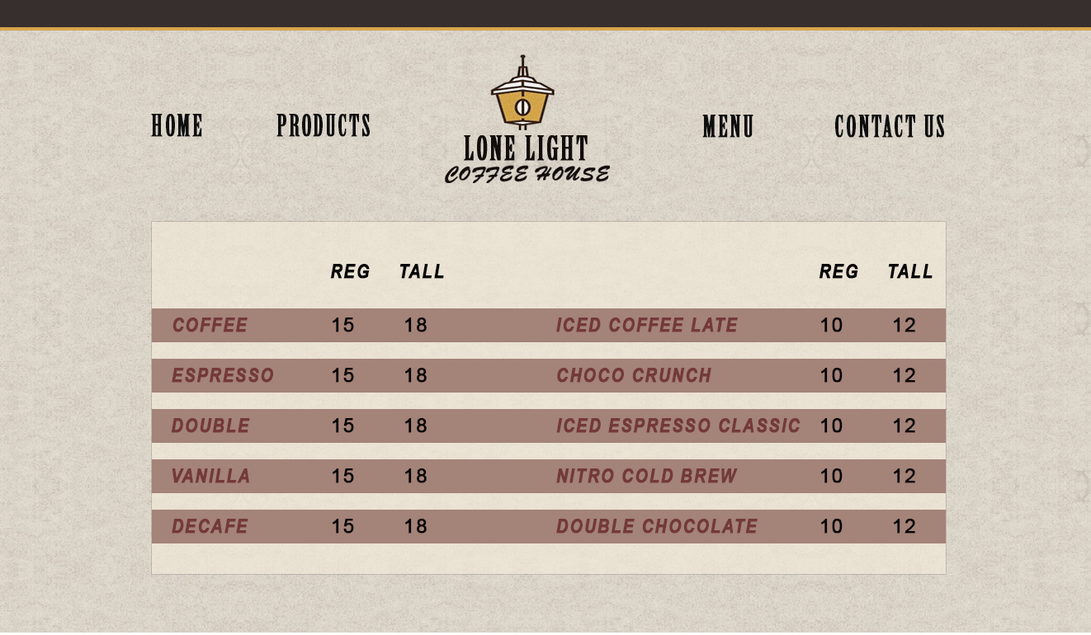
MENU
This page includes variety of coffee products served in the café.

Slide 4
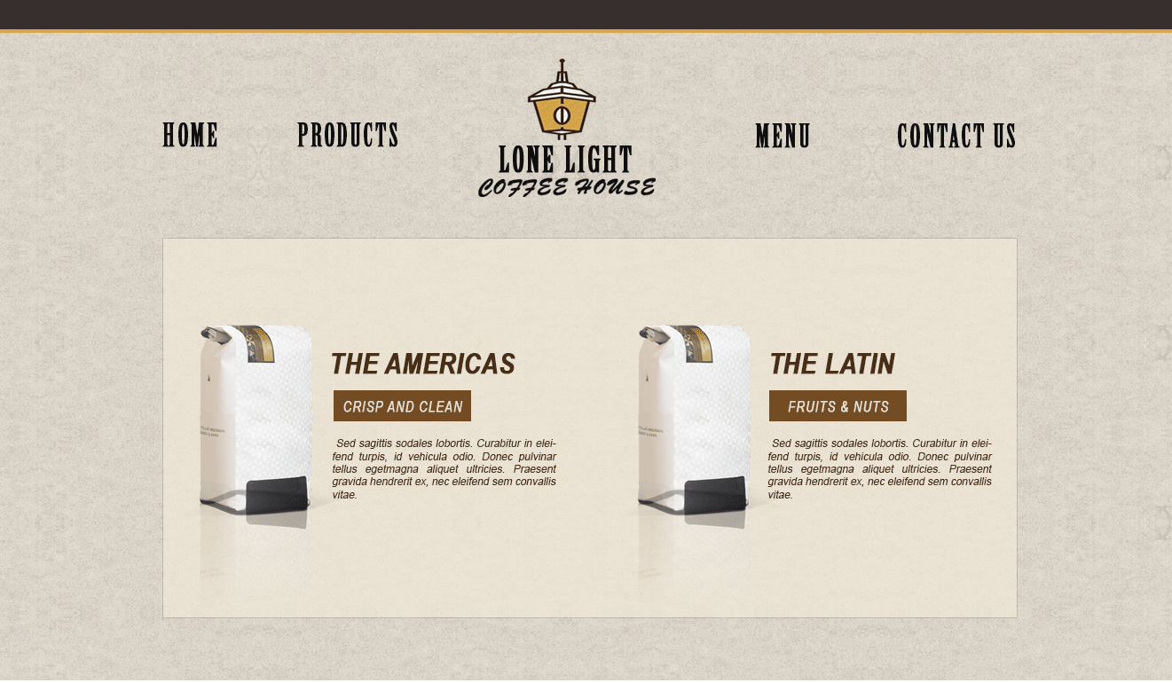
PRODUCTS
This section illustrates the coffee products available within LoneLight Café.

Slide 5
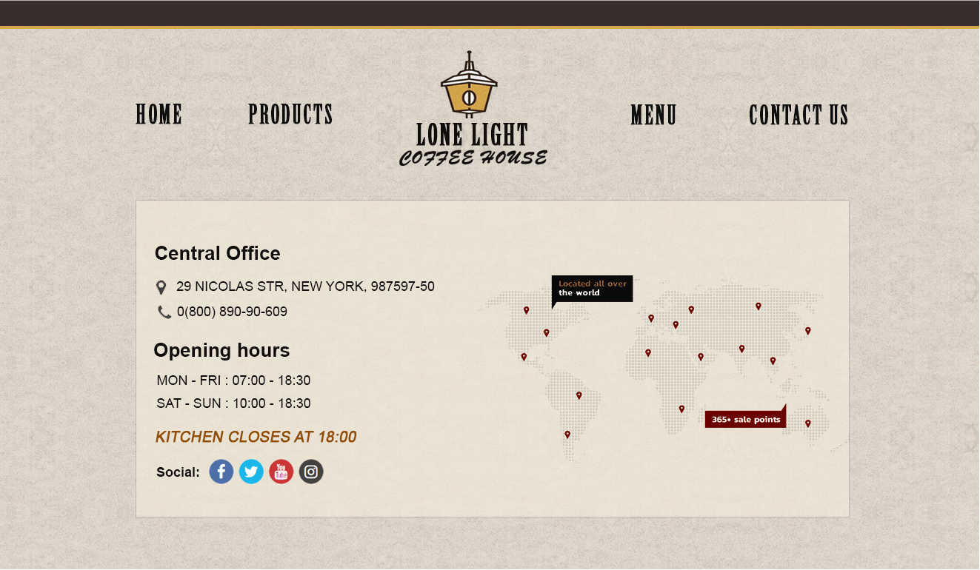
CONTACT US
This page is a way of creating a link between seller and the buyer.

Slide 6
Benefits of having online website
Helps Connect with customers
Good for advertisement of the business
Customers can easily access all information in one place
Hels the business look more professional and organized

Slide 7
Prepared By:
Jaanesh Patel
Bharat Kashyap
Mukul Trikha
Arpana Raj

